Slide 1

Temporal Graph Learning: Challenges and Recent Directions
WSDM 2023 Machine Learning on Graphs Workshop
Bryan Hooi
Assistant Professor, School of Computing
National University of Singapore

Slide 2
Many Graphs are Temporal
Graph edges often indicate interactions of various kinds, which often happen at a particular time
Users
Items (news, products, etc.)
value
value
2020/01/05
2021/01/05
Users
time
time
2021/01/06
value
Sensors
2020/01/06
time
Examples: medical / environmental / industrial sensor networks
Examples: misinformation / fraud / intrusion detection
Examples: social / citation / interaction / financial networks

Slide 3
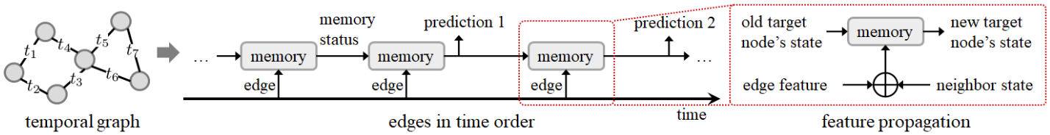
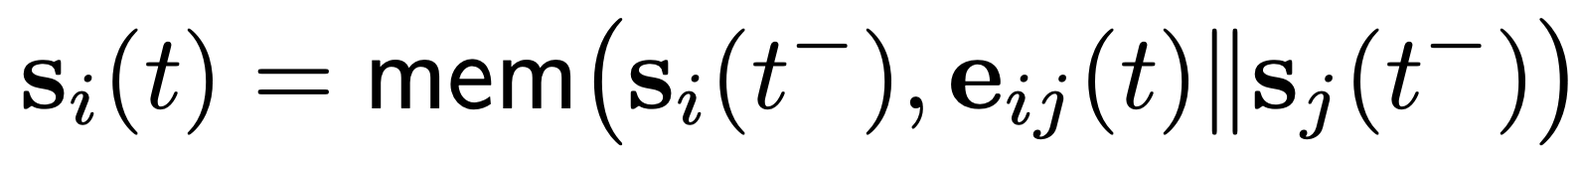
Temporal Graph Models: Basics
Many TG models (e.g. JODIE, TGAT, TGN) feed edges in time order into an RNN-based memory module, which updates each node’s state (simplified as below):
Next state (for node i at time t)
Memory update
Previous state
Edge attributes
Neighbor’s previous state

Slide 4
Summary of Directions & Challenges
Better variety of tasks and benchmarks
Esp. those that involve learning more complex and longer range temporal or graphical patterns
More powerful learning frameworks: how to go beyond relatively shallow models (e.g. 1-2 layer RNN-based models)?
Solving this challenge requires alleviating overfitting of current TG models, e.g. through better data augmentation methods

Slide 5
Summary of Directions & Challenges
Better variety of tasks and benchmarks
Esp. those that involve learning more complex and longer range temporal or graphical patterns
More powerful learning frameworks: how to go beyond relatively shallow models (e.g. 1-2 layer RNN-based models)?
Solving this challenge requires alleviating overfitting of current TG models, e.g. through better data augmentation methods

Slide 6
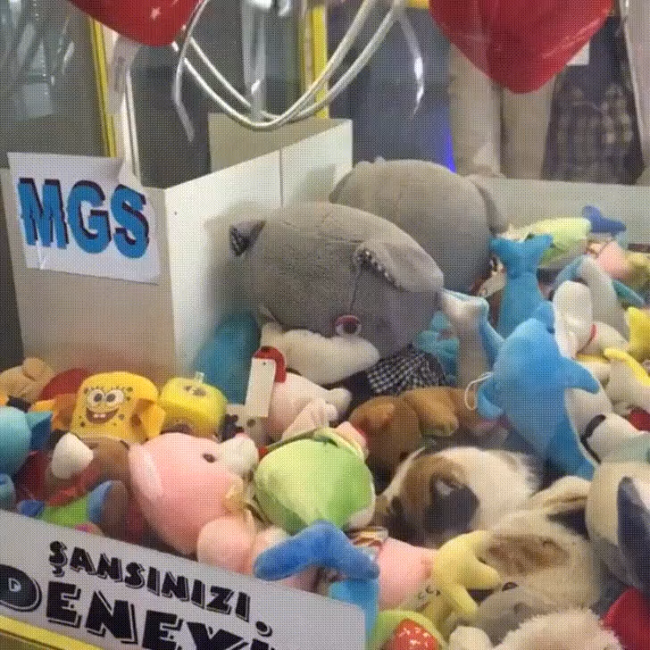
Tasks and Benchmarks
Progress in ML is often driven by high quality, diverse and challenging benchmarks: ImageNet, OGB, SQuAD, …
Currently, popular TGL benchmarks mainly only focus on 2 tasks (link prediction, dynamic node prediction), and a few relatively small datasets (no OGB-equivalent)
To improve the variety of tasks that TGL models can handle, I aim to highlight some real-world tasks that:
Can benefit from TGL
Are relatively under-explored from the TG perspective
Involve more complex temporal or graphical patterns that existing TG models cannot handle effectively

Slide 7



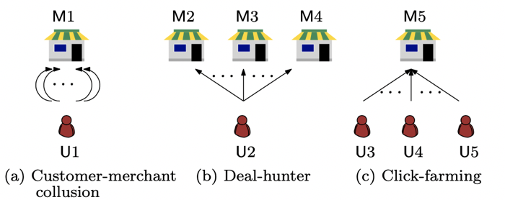
Tasks and Benchmarks
Graph-based fraud detection
Problem: given transaction tuples (user, merchant, time), identify which users / transactions represent fraudulent behavior
Public data: YelpChi, DGraph, IEEE-CIS
Jiang et al, “Spade: A Real-Time Fraud Detection Framework on Evolving Graphs.” VLDB 2023.
YelpChi (http://odds.cs.stonybrook.edu/yelpchi-dataset/), DGraph (http://yangy.org/works/dgraph/dgraph_2022.pdf), IEEE-CIS (https://www.kaggle.com/competitions/ieee-fraud-detection/data)

Slide 8
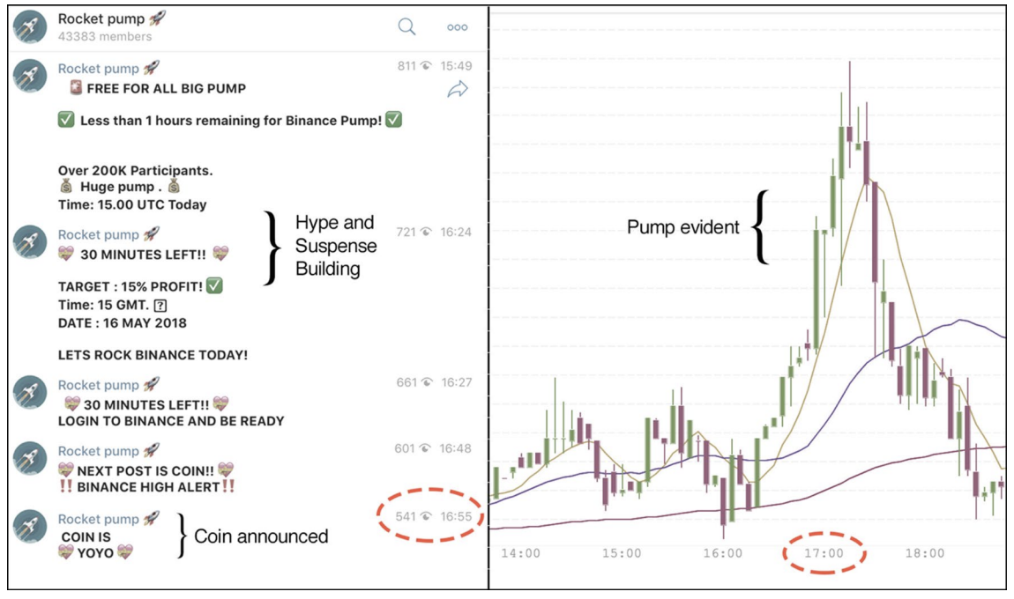
Tasks and Benchmarks
Cryptocurrency fraud detection
Problem: given financial transaction tuples (src, dst, attributes, time), identify which users / transactions represent fraudulent behavior
Public data: Elliptic (Bitcoin), TBD (Ethereum)
Elliptic (https://www.kaggle.com/ellipticco/elliptic-data-set)

Slide 9
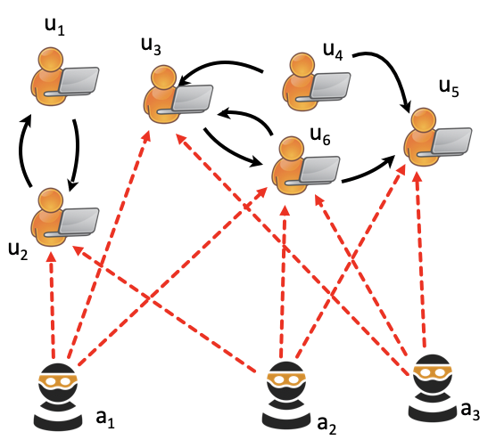
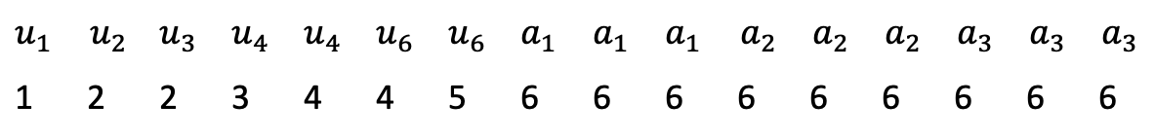
Tasks and Benchmarks
Computer network intrusion detection
Problem: given a stream of (source IP, dest IP, time) tuples, detect anomalous attacks (e.g. DDOS attacks)
Public data: UNSW-NB15, CIC-IDS
$$u_{2 }$$ | $$u_{1}$$ | $$u_{6 }$$ | $$u_{3 }$$ | $$u_{5 }$$ | $$u_{5 }$$ | $$u_{5 }$$ | $$u_{2 }$$ | $$u_{3 }$$ | $$u_{6 }$$ | $$u_{2 }$$ | $$u_{6 }$$ | $$u_{5 }$$ | $$u_{3 }$$ | $$u_{6 }$$ | $$u_{5 }$$
$$u_{1 }$$ | $$u_{2}$$ | $$u_{3 }$$ | $$u_{4 }$$ | $$u_{4 }$$ | $$u_{6 }$$ | $$u_{6 }$$ | $$a_{1 }$$ | $$a_{1 }$$ | $$a_{1 }$$ | $$a_{2}$$ | $$a_{2}$$ | $$a_{2}$$ | $$a_{3}$$ | $$a_{3}$$ | $$a_{3}$$
1 | 2 | 2 | 3 | 4 | 4 | 5 | 6 | 6 | 6 | 6 | 6 | 6 | 6 | 6 | 6
Time
Bhatia et al. “Midas: Microcluster-based detector of anomalies in edge streams”, AAAI 2020.
UNSW-NB15 (https://research.unsw.edu.au/projects/unsw-nb15-dataset), CIC-IDS (https://www.unb.ca/cic/datasets/ids-2018.html)

Slide 10
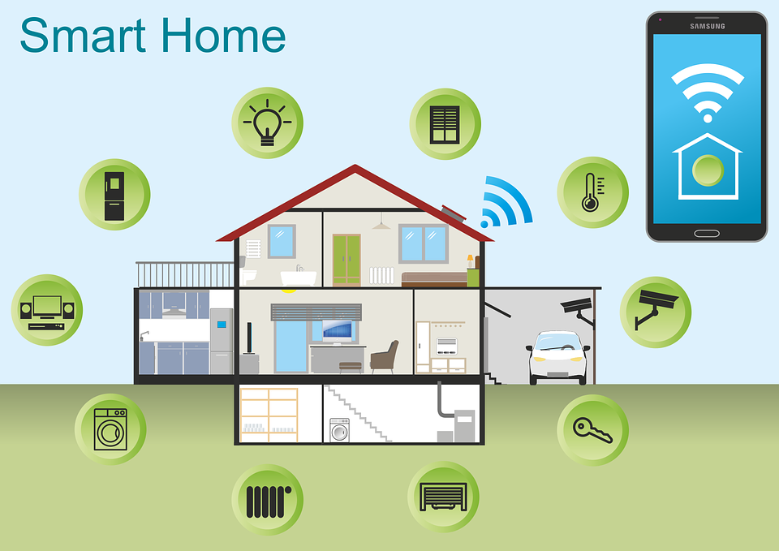
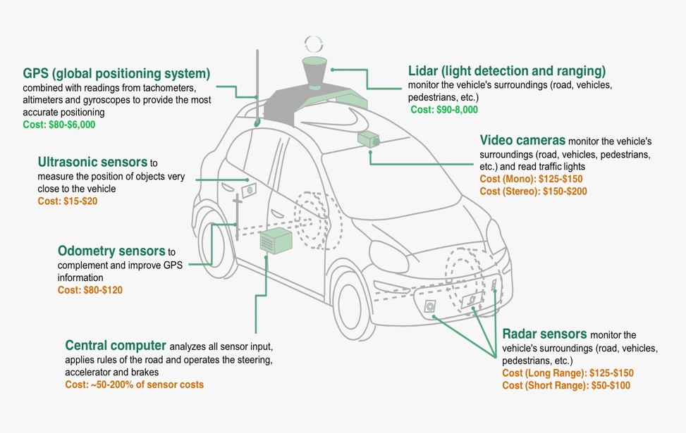
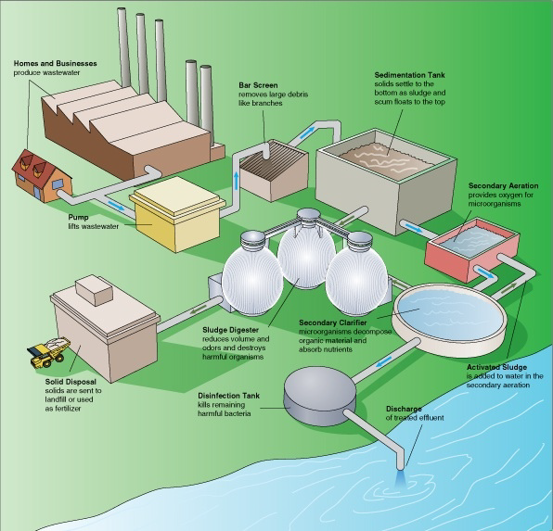
Tasks and Benchmarks
Anomaly detection in sensor systems
Increasing need to monitor interconnected sensors against attacks. Sensors systems are a natural fit for temporal graphs, but are challenging (with complex correlations and temporal patterns)

Slide 11
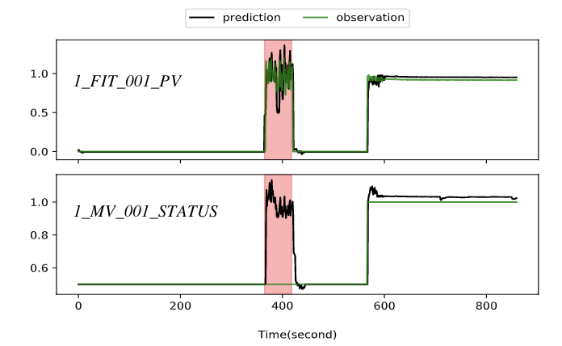
Tasks and Benchmarks
Anomaly detection in sensor systems
Problem: given multiple sensors collecting data over time, detect the time periods during which anomalous events happen
Public data: WADI, SMD
Complex temporal patterns
Complex correlations between sensors
Sensors in a water treatment plant
WADI (https://itrust.sutd.edu.sg/itrust-labs_datasets/dataset_info/), SMD (https://github.com/NetManAIOps/OmniAnomaly)

Slide 12
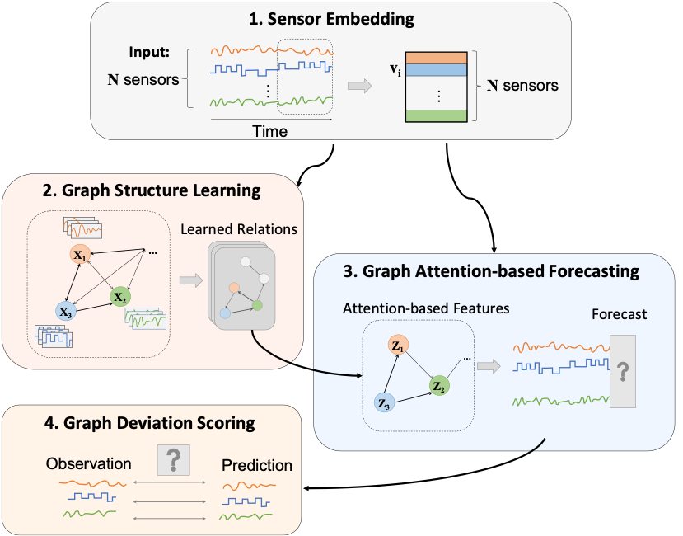
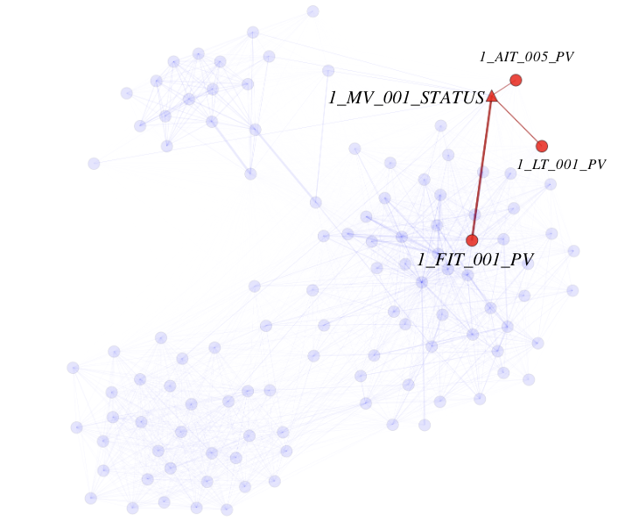
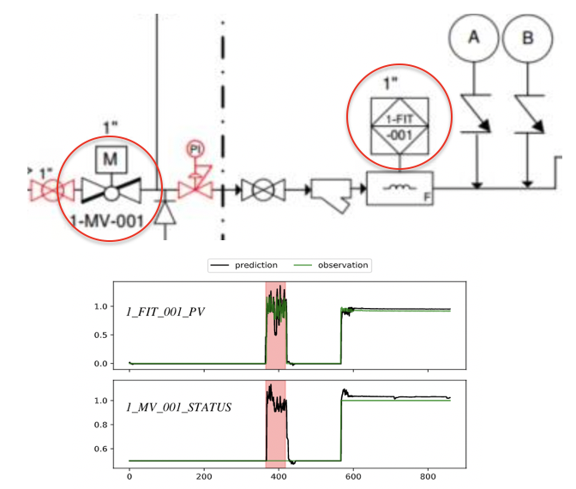
Tasks and Benchmarks
Anomaly detection in sensor systems
Approach: learn a graph of relationships between sensors; then use GNNs to model the data and detect deviations from normality
Case study: localizing an anomaly
Deng et al. "Graph neural network-based anomaly detection in multivariate time series." AAAI 21.

Slide 13
Summary of Directions & Challenges
Better variety of tasks and benchmarks
Esp. those that involve learning more complex and longer range temporal or graphical patterns
More powerful learning frameworks: how to go beyond relatively shallow models (e.g. 1-2 layer RNN-based models)?
Solving this challenge requires alleviating overfitting of current TG models, e.g. through better data augmentation methods

Slide 14
Overfitting in Temporal Graph Models
High overfitting even for shallow TGNs (1 layer):
Accuracy on transductive link prediction task
 | MOOC | LastFM | Reddit | Wikipedia
TGN (Train) | 92.8 ± 0.6 | 88.3 ± 0.3 | 96.4 ± 0.3 | 94.8 ± 0.3
TGN (Test) | 81.4 ± 0.6 | 69.4 ± 0.2 | 92.6 ± 0.2 | 89.5 ± 0.4
Train-test gap

Slide 15
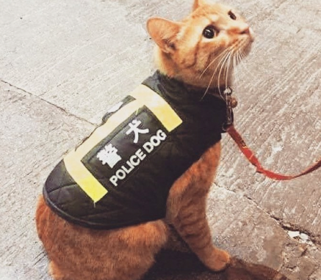
Data Augmentation
Images
Text
tf-idf based word selection
(uninformative)
(informative)
The movie was great!
crop
replace
This movie was great!
Q: How to augment temporal graphs, in a way that preserves the semantically important information?
Xie, et al. "Unsupervised data augmentation for consistency training." NeurIPS 2020

Slide 16
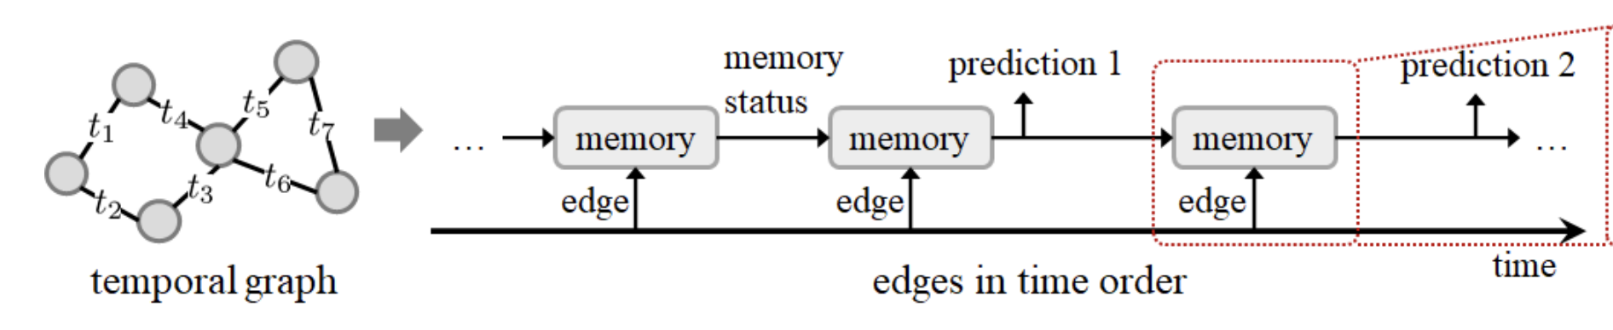
Importance of Locality
Temporal Locality: more recent edges are more informative for a given target prediction
Spatial Locality: information nearby along the graph is more informative for a given target prediction

Slide 17
Adaptive Data Augmentation
Adaptive augmentation: means applying different augmentation magnitudes depending on the given target prediction
This allows us to preserve spatially / temporally local information, by applying a lower augmentation magnitude to such information
Main difficulty: in TGNs, we compute all dynamic node embeddings in a single forward pass; so, how can we apply different augmentations for different predictions, i.e. adaptivity?

Slide 18
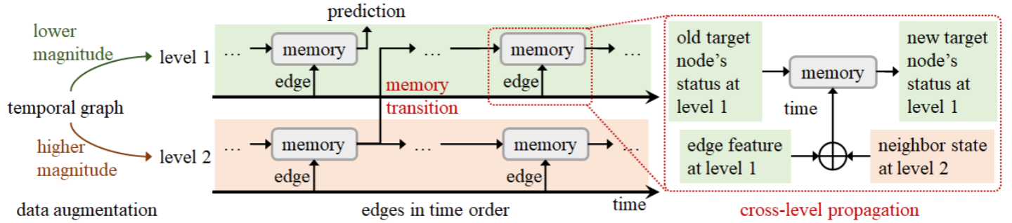
MeTA: Memory Tower for Adaptive Data Augmentation on Temporal Graphs
Main idea: generate a “tower” of differently augmented graphs, with lower magnitude augmentations applied to upper layers
Wang, et al. "Adaptive Data Augmentation on Temporal Graphs." NeurIPS 2021

Slide 19
MeTA: Memory Tower for Adaptive Data Augmentation on Temporal Graphs
Main idea: generate a “tower” of differently augmented graphs, with lower magnitude augmentations applied to upper layers
TG model is applied to each layer with weight sharing. Predictions are made only at the top level
At bottom layer: TG model is applied normally (on augmented graph)

Slide 20
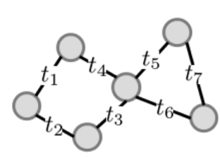
MeTA: Memory Tower for Adaptive Data Augmentation on Temporal Graphs
Cross-level propagation: to allow spatial locality, nodes at level i receive messages from neighbors at level i+1
Thus, information about more distant neighbors comes from layers which experienced higher magnitude data augmentation

Slide 21
MeTA: Memory Tower for Adaptive Data Augmentation on Temporal Graphs
Memory transitions: to allow temporal locality, embeddings are periodically transmitted from layer i+1 to layer i
Thus, information from further in the past comes from layers which experienced higher magnitude data augmentation

Slide 22
MeTA: Augmentations Used
Perturb Time
Remove Edges
Add Edges with Perturbed Time
Avoiding train-test distribution shift: the 3 augmentations are done in a way that avoids unnecessary train-test distribution shift, to minimize the train-test gap
Under certain assumptions, we show that our augmentations do not change the distribution of edge times, and number of edges

Slide 23
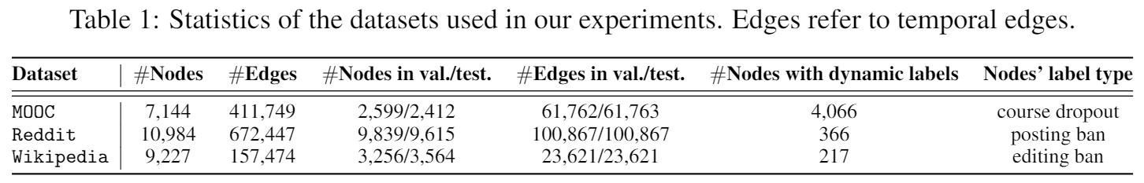
Experiments
Tasks: link prediction, dynamic node classification

Slide 24
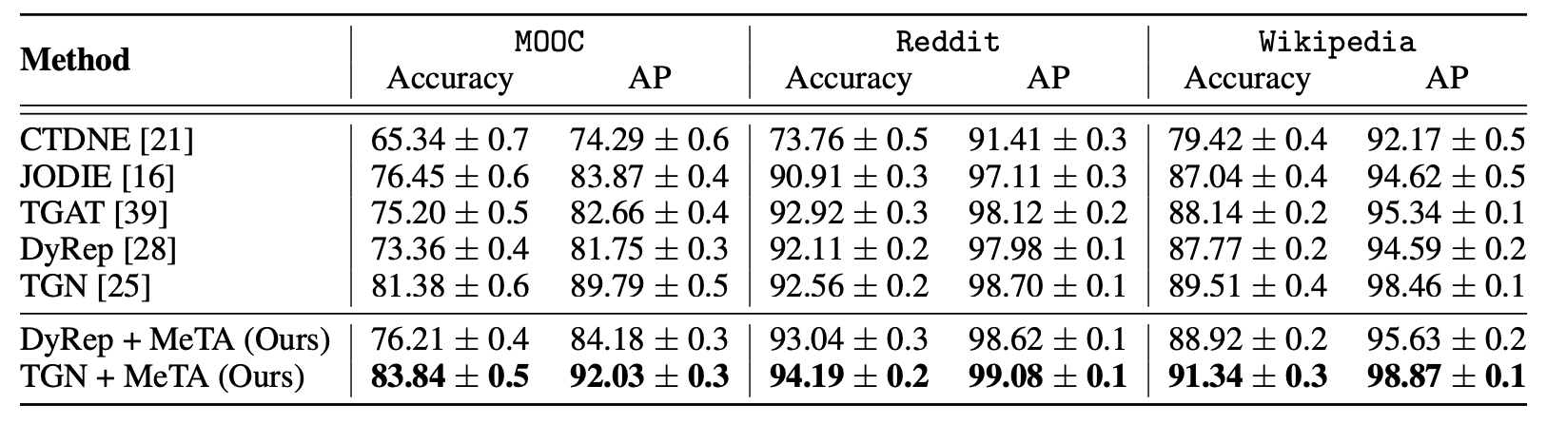
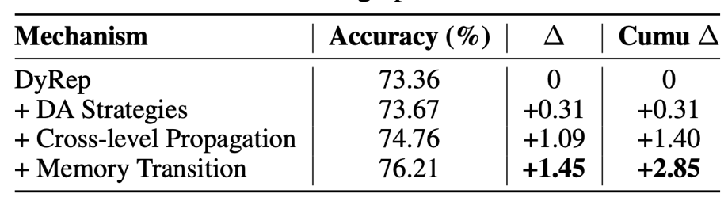
Link Prediction Performance
Transductive
Inductive
Other results in paper: more baselines, ablations, and similar improvements on Mean Reciprocal Rank (MRR)

Slide 25
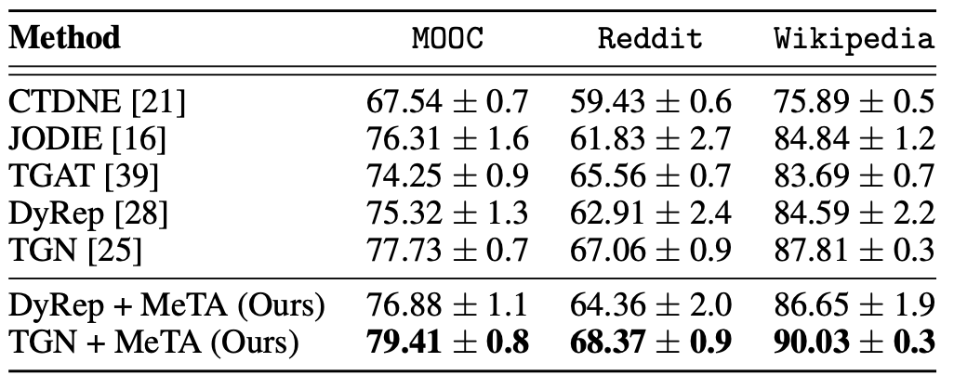
Node Classification Performance
Comparison to recent augmentation methods:
Method | MOOC | Reddit | Wikipedia
TGN [5] | 77.73 ± 0.7 | 67.06 ± 0.9 | 87.81 ± 0.3
TGN + FLAG [4] | 77.79 ± 0.6 | 67.15 ± 0.8 | 87.89 ± 0.6
TGN + GAUG [3] | 77.82 ± 0.8 | 67.09 ± 0.9 | 87.85 ± 0.5
TGN + MeTA (Ours) | 79.41 ± 0.8 | 68.37 ± 0.9 | 90.03 ± 0.3

Slide 26
Reduction in Overfitting
 | MOOC | LastFM | Reddit | Wikipedia
TGN (Train) | 92.8 ± 0.6 | 88.3 ± 0.3 | 96.4 ± 0.3 | 94.8 ± 0.3
TGN (Test) | 81.4 ± 0.6 | 69.4 ± 0.2 | 92.6 ± 0.2 | 89.5 ± 0.4
TGN+MeTA (Train) | 86.2 ± 0.3 | 77.1 ± 0.2 | 96.1 ± 0.2 | 93.6 ± 0.2
TGN+MeTA (Test) | 83.8 ± 0.5 | 72.2 ± 0.2 | 94.2 ± 0.2 | 91.3 ± 0.3
Train-test gap
Train-test gap

Slide 27
MeTA: Summary
Allows adaptive data augmentation using “tower” of graphs (in practice, 2 levels is sufficient)
MeTA is general: it is agnostic to the choice of TG model, and the choice of data augmentations

Slide 28
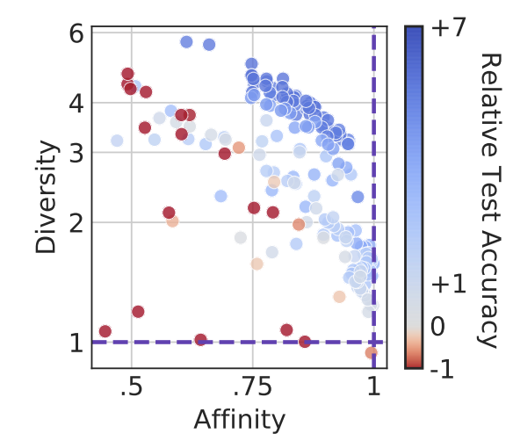
MeTA: Future Directions
Better understanding of benefits of adaptivity:
Many recent works seek to explain the benefits of DA, e.g. [1] saying that effective data augmentations should have both high affinity (i.e. label-preserving) and diversity.
Intuitively, adaptive DA should allow for greater diversity while still ensuring affinity.
Developing more powerful TG architectures (since MeTA has greatly reduced overfitting)
Learnable data augmentation (similar to AutoAugment)
Exploring adaptivity (+ similar computational tricks) for other data types
[1] Gontijo-Lopez et al, “Tradeoffs in Data Augmentation: An Empirical Study”, ICLR 2021

Slide 29
Conclusion
Many emerging opportunities for:
Bringing TG learning to new applications; and
Developing new powerful models which can learn more complex patterns found in such applications
Buldú et al. "Defining a historic football team: Using Network Science to analyze Guardiola’s FC Barcelona." Scientific reports, 2019

Slide 30
Thank You!

